Slide 1
FINAL YEAR B.TECH PROJECT | ARTIFICIAL INTELLIGENCE & NLP
AI-Powered Fake NewsDetection System
Machine Learning + Natural Language Processing to classify news articles as REAL or FAKE
Presented by Lahya Sree BollinkalaB.Tech — Computer Science & Engineering
Python
Scikit-Learn
TF-IDF
NLTK
Streamlit
Plotly
Academic Year 2025–26 • Department of Computer Science & Engineering
Notes:
Good morning everyone. I am Lahya Sree Bollinkala, and today I will present my Final Year B.Tech project titled 'AI-Powered Fake News Detection System'. In an era where information spreads at the speed of a click, this project builds a Machine Learning and NLP based system that automatically classifies news articles as REAL or FAKE. The system uses TF-IDF text features, four ML models benchmarked on a 44,898-article dataset, and a fully interactive Streamlit dashboard for real-time and batch prediction.
[VIVA] Q: What is this project about?
A: It is an end-to-end ML pipeline that preprocesses news text, converts it to TF-IDF features and classifies articles as Real or Fake using supervised models, deployed as a Streamlit web application.
[VIVA] Q: Which tools did you use?
A: Python, Scikit-Learn, NLTK for text cleaning, TF-IDF vectorization, Streamlit for the UI and Plotly for charts.

Slide 2
Project Overview
An end-to-end pipeline from raw text to deployable prediction engine
Fake news spreads rapidly through social media and online platforms, making it difficult for users to distinguish genuine information from misleading content. This project builds an automated detection system that analyzes the textual content of news articles using NLP and supervised Machine Learning, then predicts whether an article is REAL or FAKE with a confidence score.
KEY HIGHLIGHTS
• NLP text cleaning pipeline (NLTK)
• TF-IDF vectorization, 5,000 features
• Logistic Regression, Random Forest, MLP & KNN
• 80 / 20 stratified train-test split
44,898Labelled news articles
4ML models benchmarked
99.86%Best model accuracy
5Streamlit dashboard tabs
• Real-time + batch prediction UI
AI-Powered Fake News Detection System
2
Notes:
This slide gives the big picture. The system takes raw news articles, applies an NLP preprocessing pipeline, converts the text into TF-IDF feature vectors, and feeds them to Machine Learning classifiers. Four models were benchmarked and the best one, Random Forest, achieves 99.86% accuracy on the held-out test set. Everything is wrapped in a five-tab Streamlit dashboard so non-technical users can detect fake news in real time or in bulk.
[VIVA] Q: What is TF-IDF?
A: Term Frequency-Inverse Document Frequency: it weights words that are frequent in a document but rare across the corpus, which makes them discriminative for classification.
[VIVA] Q: Why is a confidence score useful?
A: It shows how certain the model is, so borderline cases can be flagged for manual review.

Slide 3
Motivation
Why automated fake news detection is essential today
Rapid SpreadFake news propagates across social media faster than the truth, reaching millions before correction.
Misinformation HarmsMisleading news influences public opinion, health decisions, elections and stock markets.
1
3
Hard to Verify ManuallyHumans and fact-checkers cannot scale to the volume of articles published every minute.
Automation is the AnswerNLP + Machine Learning can screen articles instantly, objectively and at scale.
2
4
The goal: give every reader an instant, explainable signal of credibility.
AI-Powered Fake News Detection System
3
Notes:
Why did I choose this problem? First, the sheer speed at which fake news spreads on social media — it reaches more people in less time than real news. Second, manual fact-checking cannot keep up with the volume of content generated every minute. Third, misinformation has real consequences in health, politics and finance. The logical conclusion is that we need an automated, NLP-based screening system that works instantly and consistently at scale.
[VIVA] Q: What makes fake news a serious problem?
A: It influences opinions and decisions while spreading faster and wider than verified news.
[VIVA] Q: Why can't a simple keyword filter work?
A: Fake news is written to mimic real news; a keyword approach produces many false positives and misses nuanced misinformation.

Slide 4
Problem Statement
The precise challenge addressed by this project
“Design and develop an automated system that accurately classifies news articles as REAL or FAKE from their textual content, using Natural Language Processing and Machine Learning, and delivers the result through an accessible web interface with confidence scoring.”
1
Extract meaningful patterns from unstructured news text
2
Handle text noise: case, punctuation, URLs, stopwords, morphology
3
Choose the most accurate classifier among four ML architectures
4
Present predictions to users with confidence and analytics
AI-Powered Fake News Detection System
4
Notes:
The formal problem statement is on screen: build a system that decides whether a news article is Real or Fake purely from its text. The technical challenges are treating noisy unstructured text, engineering discriminative features, benchmarking multiple classifiers, and finally delivering the solution through a usable interface with confidence scoring so the output is actionable.
[VIVA] Q: Why is text classification hard?
A: Text is unstructured, high-dimensional and noisy — it needs cleaning, tokenization and weighting before a classifier can use it.
[VIVA] Q: What is your target variable?
A: A binary label: 0 for Real and 1 for Fake.

Slide 5
Objectives
What this project set out to achieve
Build an NLP preprocessing pipelineclean_text() removes URLs, HTML, digits, punctuation, stopwords and lemmatizes tokens using NLTK.
Engineer TF-IDF featuresTfidfVectorizer with 5,000 features, unigram+bigram n-grams and min_df=2.
01
02
Benchmark four ML classifiersLogistic Regression, Random Forest, MLP and KNN trained on a stratified 80/20 split.
Select the best model by F1 scoreModel artifacts serialized for reuse (best_model.pkl, vectorizer.pkl).
03
04
Deploy an interactive dashboardStreamlit app with 5 tabs: Detector, Batch, Models, Dataset and History.
Provide confidence + analyticsPer-prediction probability, confidence gauge, charts and a downloadable history log.
05
06
AI-Powered Fake News Detection System
5
Notes:
The project has six concrete objectives: build a clean preprocessing pipeline; convert text into TF-IDF features; train and benchmark four classifiers; select the best model based on F1 score; deploy everything into an interactive Streamlit dashboard; and provide confidence scores together with analytics and a prediction history log. Each objective maps to a module in the src/ folder, which makes the codebase easy to explain in the viva.
[VIVA] Q: Which metric was used for model selection and why?
A: F1 score — it balances precision and recall, which is important because both false alarms and missed fakes are costly.
[VIVA] Q: How are the objectives mapped to code?
A: Preprocessing -> src/preprocessing.py and src/utils.py; features -> src/feature_engineering.py; models -> src/train_models.py; evaluation -> src/evaluate_models.py; UI -> app/app.py.

Slide 6
Existing System
Limitations of conventional approaches
Manual Fact-Checking
No Confidence Quantification
Journalists and agencies verify stories by hand — accurate but extremely slow and impossible to scale to real-time volumes.
Most existing tools return a verdict without a probability, offering no measure of certainty.
Keyword / Heuristic Filters
Standalone & Static
Rule-based keyword matching and blacklists trigger too many false positives because fake news mimics real language.
Existing solutions often lack an accessible interface, batch support, analytics or prediction history.
Gap: no single, scalable, confidence-aware, web-accessible detector.
AI-Powered Fake News Detection System
6
Notes:
Before proposing my solution, I analysed the existing approaches. Manual fact-checking by journalists is accurate but cannot scale. Simple keyword filters and blacklists are fast but brittle — fake news is deliberately written to look like real news. Most existing tools also fail to quantify confidence, and very few are packaged as an accessible dashboard with batch support and analytics. That gap is exactly what this project fills.
[VIVA] Q: Why do keyword filters fail?
A: Fake news shares most vocabulary with real news; lexical cues alone are not discriminative enough, causing many false positives.
[VIVA] Q: What is the biggest weakness of manual checking?
A: Speed and scale — it cannot keep pace with social-media dissemination.

Slide 7
Proposed System
An end-to-end, data-driven detection framework
A supervised ML + NLP pipeline that converts article text into TF-IDF features and classifies it as REAL or FAKE, delivered through a Streamlit web dashboard.
Text PipelineCleaning, tokenization, stopword removal & lemmatization
Feature EngineTF-IDF vectorization to a 5,000-dimension sparse matrix
ML ClassifierRandom Forest — best of 4 benchmarked models
Prediction + UIVerdict, confidence %, charts & history log in Streamlit
01
02
03
04
Key outcomes • 99.86% test accuracy • 99.99% ROC-AUC • 1–click real-time detection • bulk CSV prediction • exportable history
AI-Powered Fake News Detection System
7
Notes:
My proposed system is a supervised Machine Learning plus NLP framework. There are four pillars: a text preprocessing pipeline, a TF-IDF feature engine producing a 5,000-dimensional sparse matrix, a Random Forest classifier selected as the best among four models, and finally a Streamlit dashboard for predictions. The pipeline is modular — each stage is a separate Python module — so it can be explained and improved independently.
[VIVA] Q: Why is the pipeline modular?
A: Separation of concerns: preprocessing, features, training, evaluation and UI are independent modules, which aids testing and future upgrades.
[VIVA] Q: What is the system boundary?
A: Input is raw text (or CSV), output is a verdict with confidence; the deployed model loads best_model.pkl and vectorizer.pkl.

Slide 8
Dataset Description
GlobalFakeNews_Research2026_v1.csv
Built by combining two public news corpora — Fake.csv and True.csv (ISOT-style dataset) — labelled as Fake (1) and Real (0), with heuristic metadata added by src/prepare_dataset.py.
Column | Type | Description
full_text | Text | Concatenated article title + body
label | Binary | Target variable (0 = Real, 1 = Fake)
sentiment_score | Float | Polarity of article text (-1.0 to +1.0)
clickbait_score | Float | Clickbait probability (0.0 to 1.0)
emotional_word_ratio | Float | Density of emotional words
readability_score | Float | Flesch reading ease (approx.)
source_trust_score | Float | Publisher trust rating (heuristic)
44,898
21,417
Total Articles
Real (47.7%)
23,481
0
Fake (52.3%)
Missing Values
Prepared data7 columns, nearly-balanced classes, no missing values, ~418 words per article on average.
AI-Powered Fake News Detection System
8
Notes:
The dataset is a combination of two widely used ISOT-style corpora: Fake.csv, which contains fake articles, and True.csv, which contains real articles. The script src/prepare_dataset.py concatenates both, assigns labels 1 and 0, creates a full_text column, and computes five heuristic metadata scores. The final dataset has 44,898 articles and 7 columns, is nearly balanced and has no missing values.
[VIVA] Q: Where does the data come from?
A: Fake.csv and True.csv are the classic ISOT fake-news corpora, combined and enriched with metadata by prepare_dataset.py.
[VIVA] Q: Is the dataset balanced?
A: Yes — approximately 52.3% Fake and 47.7% Real, which is why a stratified split was used.

Slide 9
Dataset Statistics
Verified directly from the dataset files
44,898
23,481 / 52.3%
Total articles
Fake articles
21,417 / 47.7%
0
Real articles
Missing values
≈ 418
≈ 2,551
Avg. words / article
Avg. characters / article
Balanced classes allow a stratified 80/20 split — 35,918 training / 8,980 test samples, preserving class proportion in both sets.
AI-Powered Fake News Detection System
9
Notes:
Here are the exact statistics I verified from the dataset files. There are 44,898 articles: 23,481 fake (52.3%) and 21,417 real (47.7%). There are zero missing values. The average article contains about 418 words and roughly 2,551 characters. Because the classes are nearly balanced, I used a stratified 80/20 split, giving 35,918 training and 8,980 test samples while preserving the class distribution.
[VIVA] Q: Why a stratified split?
A: Stratification keeps the same class proportion in train and test, giving more reliable and representative evaluation metrics.
[VIVA] Q: What is the training-to-test ratio?
A: 80% training (35,918) and 20% testing (8,980) with random_state=42 for reproducibility.

Slide 10
Data Preprocessing
clean_text() — src/utils.py & src/preprocessing.py
Lowercaseconvert all text to lower case
Strip URLsremove http(s)/www links
Remove HTMLstrip <...> tags
Drop digitsremove numeric characters
Punctuationstrip punctuation marks
StopwordsNLTK English stopword list
LemmatizeWordNet lemmatizer
1
2
3
4
5
6
7
Example transformation
Raw : Scientists have confirmed that drinking 10 cups of coffee every hour makes people invisible!
Clean : scientist confirm drinking cup coffee every hour make people invisible
AI-Powered Fake News Detection System
10
Notes:
Preprocessing is handled by the clean_text function in src/utils.py and src/preprocessing.py. The pipeline lowercases text, removes URLs, strips HTML tags, drops digits and punctuation, collapses whitespace, then tokenizes and removes English stopwords using NLTK, and finally lemmatizes words to their base forms using WordNet. The example on screen shows a raw sentence being converted to its cleaned form.
[VIVA] Q: Why lemmatization instead of stemming?
A: Lemmatization uses a dictionary (WordNet) to return the actual root form of a word, which preserves meaning better than crude prefix-stripping stemming.
[VIVA] Q: What does stopword removal do?
A: It removes high-frequency, low-information words (the, a, and, of) so the feature matrix focuses on content-bearing terms.

Slide 11
Feature Engineering
src/feature_engineering.py — TF-IDF text features
Parameter | Value | Why it matters
max_features | 5,000 | Bounds vocabulary size, controls dimensionality
ngram_range | (1, 2) | Captures single words + word pairs (bigrams)
min_df | 2 | Drops terms appearing in fewer than 2 documents
Output | Sparse matrix | 44,898 docs × 5,000 features
Splits saved | X_train / X_test | 35,918 / 8,980 rows (stratified 80/20)
Feature space concept
44,898 documents×5,000 TF-IDF terms
Sparse TF-IDF matrixonly non-zero weights stored
Why sparse?Each article uses only a small fraction of the vocabulary, so the matrix is stored efficiently in CSR format, saving memory and speeding up training.
AI-Powered Fake News Detection System
11
Notes:
Feature engineering is done in src/feature_engineering.py. A TfidfVectorizer is configured with max_features=5000, ngram_range (1,2) — that means both single words and bigrams — and min_df=2 to remove very rare terms. The result is a sparse matrix with 44,898 documents and 5,000 features. Because any given article contains only a fraction of the vocabulary, most matrix entries are zero, so we store it as a sparse CSR matrix. The train and test splits are saved to disk for the training stage.
[VIVA] Q: What does ngram_range=(1,2) mean?
A: Features include both individual tokens (1-grams) and adjacent two-word phrases (2-grams), capturing common wording and collocations.
[VIVA] Q: What is min_df and why use it?
A: min_df=2 keeps only terms that appear in at least two documents, removing typos and one-off terms that add noise.

Slide 12
TF-IDF Vectorization
How raw text becomes numeric features
Term Frequencyhow often term t occurs in document d
Inverse Document Frequencyrarity of term across all documents
Weighted Scoretf × idf — high for distinctive terms
TF
IDF
TF-IDF
weight(t, d) = tf(t, d) × log( N / df(t) )where tf = term frequency in d, N = total documents, df = documents containing t
Why it helps detection: common words get low weight while rare, content-specific terms — the kind fake headlines over-use — get high weight, giving the classifier strong discriminative signals.
AI-Powered Fake News Detection System
12
Notes:
TF-IDF stands for Term Frequency - Inverse Document Frequency. Term frequency counts how often a word appears in a document. Inverse document frequency measures how rare the word is across the whole corpus. The final weight is the product: tf multiplied by log of N divided by document frequency. This naturally down-weights stopwords and boosts distinctive, content-bearing terms, which makes the resulting vectors very informative for the classifier.
[VIVA] Q: Can you write the TF-IDF formula?
A: weight(t,d) = tf(t,d) × log(N/df(t)). N is the number of documents and df(t) is the number of documents containing term t.
[VIVA] Q: Why not use simple word counts?
A: Raw counts over-weight common words; TF-IDF normalizes by rarity so discriminative terms dominate.

Slide 13
Machine Learning Models
Four architectures benchmarked — src/train_models.py
Logistic Regression
Random Forest
Neural Network (MLP)
K-Nearest Neighbors
Linear
Ensemble
Deep learning
Instance-based
• max_iter = 1000
• n_estimators = 200
• hidden layers (128, 64)
• k = 5 neighbors
• random_state = 42
• random_state = 42
• max_iter = 500
• majority vote
Baseline linear model on sparse features
Ensemble of decision trees; selected best model
Multi-Layer Perceptron with ReLU layers
Lazy learner; distance-based prediction
AI-Powered Fake News Detection System
13
Notes:
I benchmarked four classifiers. Logistic Regression is a linear baseline trained with up to 1000 iterations. Random Forest is an ensemble of 200 decision trees — this became the best model. The MLP is a neural network with two hidden layers of 128 and 64 neurons. KNN is a lazy learner using 5 nearest neighbours. All models were trained on the same TF-IDF matrix and evaluated on the same held-out test set to guarantee a fair comparison.
[VIVA] Q: Why compare four different families?
A: Each family has different assumptions: linear, tree-based, neural, and distance-based. Comparing them shows which inductive bias suits sparse TF-IDF news text.
[VIVA] Q: What are Random Forest hyperparameters?
A: n_estimators=200 (number of trees) and random_state=42; the default max_depth was left at 'None', so trees grow to full depth.

Slide 14
Model Training Pipeline
From cleaned text to serialized best model
Load Data
cleaned_news.csv
44,898 rows
TF-IDF
5,000 features
sparse matrix
Split
80/20 stratified
35,918 / 8,980
Train
4 models
fit on train
Evaluate
metrics on test
acc, F1, AUC
Select
best by F1
Random Forest
Save
best_model.pkl
metrics.json
Artifacts produced by the pipeline
models/best_model.pkl
models/vectorizer.pkl
models/feature_names.pkl
Trained Random Forest (5000 features)
Fitted TF-IDF vectorizer
5,000 learned feature names
models/X_train.pkl
models/X_test.pkl
results/model_metrics.json
Sparse training matrix (35,918 × 5,000)
Sparse test matrix (8,980 × 5,000)
All 4 models × 5 metrics + best model name
AI-Powered Fake News Detection System
14
Notes:
This is the training pipeline I followed. First I load the cleaned corpus, then I vectorize it into a sparse TF-IDF matrix with 5,000 features. Next I split into 80% train and 20% test with stratification. I train all four models, evaluate them on the test set, and select the one with the highest F1 score — Random Forest. Finally I serialize the artifacts: the model, the vectorizer, feature names and train/test matrices, plus a JSON file with all metrics, which the dashboard reads to display benchmark tables and charts.
[VIVA] Q: How do you make the comparison fair?
A: Every model is trained and evaluated on the exact same TF-IDF features and the exact same stratified train/test split.
[VIVA] Q: Why save X_train / X_test?
A: It avoids re-vectorizing the whole corpus each time and makes experiments reproducible and fast to iterate on.

Slide 15
Model Comparison
Actual results from results/model_metrics.json
Model | Acc | Prec | Rec | F1 | ROC-AUC
Logistic Regression | 0.9909 | 0.9944 | 0.9881 | 0.9912 | 0.9996
Random Forest | 0.9986 | 0.9989 | 0.9983 | 0.9986 | 0.9999
Neural Network | 0.9938 | 0.9934 | 0.9947 | 0.9940 | 0.9996
KNN | 0.7308 | 0.6681 | 0.9644 | 0.7894 | 0.8052
Best: Random Forest — F1 = 0.9986, ROC-AUC = 0.9999
Observation: tree ensembles and neural models handle sparse TF-IDF input well; KNN underfits the 5,000-dimensional feature space.
AI-Powered Fake News Detection System
15
Notes:
These are the exact numbers from results/model_metrics.json. Random Forest leads on every metric: 99.86% accuracy, 99.89% precision, 99.83% recall, 99.86% F1 and a ROC-AUC of 0.9999. Logistic Regression and the MLP are close seconds with F1 around 99%. KNN clearly underperforms — about 79% F1 — because distance-based learning struggles in a 5,000-dimensional sparse space. The chart on the left is an editable native chart you can adjust directly in PowerPoint.
[VIVA] Q: Why does Random Forest beat logistic regression?
A: Random forests capture non-linear interactions between features and are robust on sparse high-dimensional input without needing feature scaling.
[VIVA] Q: Why does KNN fail here?
A: In 5,000-dimensional space the concept of nearest neighbours degrades (curse of dimensionality), and KNN is sensitive to sparse binary-style input.

Slide 16
Evaluation Metrics
How model quality is measured
Accuracy
Precision
Recall
F1 Score
ROC-AUC
Correct predictions ÷ all predictions
True positives ÷ all predicted positive
True positives ÷ all actual positive
Harmonic mean of precision & recall
Area under the ROC curve (0–1)
0.9986
0.9989
0.9983
0.9986
0.9999
Class mapping: Real = 0, Fake = 1. Precision measures how many flagged articles are genuinely fake; recall measures how many fake articles we catch.
AI-Powered Fake News Detection System
16
Notes:
The models are evaluated with five standard metrics. Accuracy is the share of correct predictions. Precision tells us how many articles we flagged as Fake are actually fake — important to avoid false accusations. Recall tells us how many fake articles we actually catch. F1 is the harmonic mean of precision and recall and was my model-selection criterion. ROC-AUC measures how well the model ranks fake articles above real ones, independent of any threshold.
[VIVA] Q: Difference between precision and recall?
A: Precision = TP/(TP+FP), focuses on trustworthiness of positive predictions; Recall = TP/(TP+FN), focuses on how complete the detection is.
[VIVA] Q: Why F1 for model selection?
A: It balances precision and recall into one number, so a model that is great at one but terrible at the other is penalised.

Slide 17
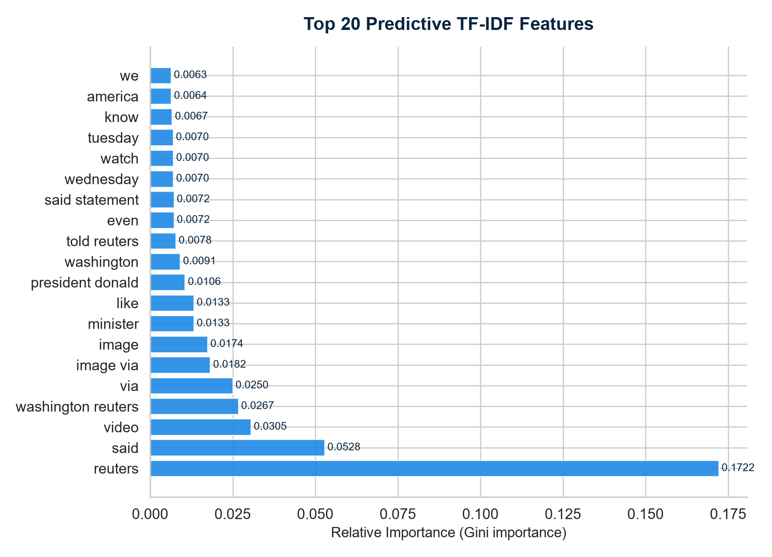
Experimental Results
Best model: Random Forest — verified on 8,980 test articles
99.86%
99.89%
99.83%
Accuracy
Precision
Recall
99.86%
0.9999
F1 Score
ROC-AUC
Random Forest classifies 8,980 held-out articles with only ~13 errors — near-perfect separation of the two classes on this corpus.Runner-up: Neural Network (F1 = 0.9940) and Logistic Regression (F1 = 0.9912).
Top TF-IDF features driving the Random Forest decision
AI-Powered Fake News Detection System
17
Notes:
On the held-out test set of 8,980 articles, the Random Forest reaches 99.86% accuracy, 99.89% precision, 99.83% recall, 99.86% F1 and a ROC-AUC of 0.9999. That means roughly 13 misclassifications across the whole test set. The chart shows the twenty TF-IDF terms with the highest Gini importance in the Random Forest — these are the signals the model relies on most. I have to be honest that these results are on this benchmark dataset; on totally unseen real-world news, performance may vary with content diversity.
[VIVA] Q: How many test errors does 99.86% imply?
A: 8,980 test articles at 99.86% accuracy implies about 12–13 errors, roughly 6 per class.
[VIVA] Q: Which features matter most?
A: The feature-importance chart shows the top TF-IDF terms; the model weights content-specific words and phrases that differ strongly between real and fake reporting.

Slide 18
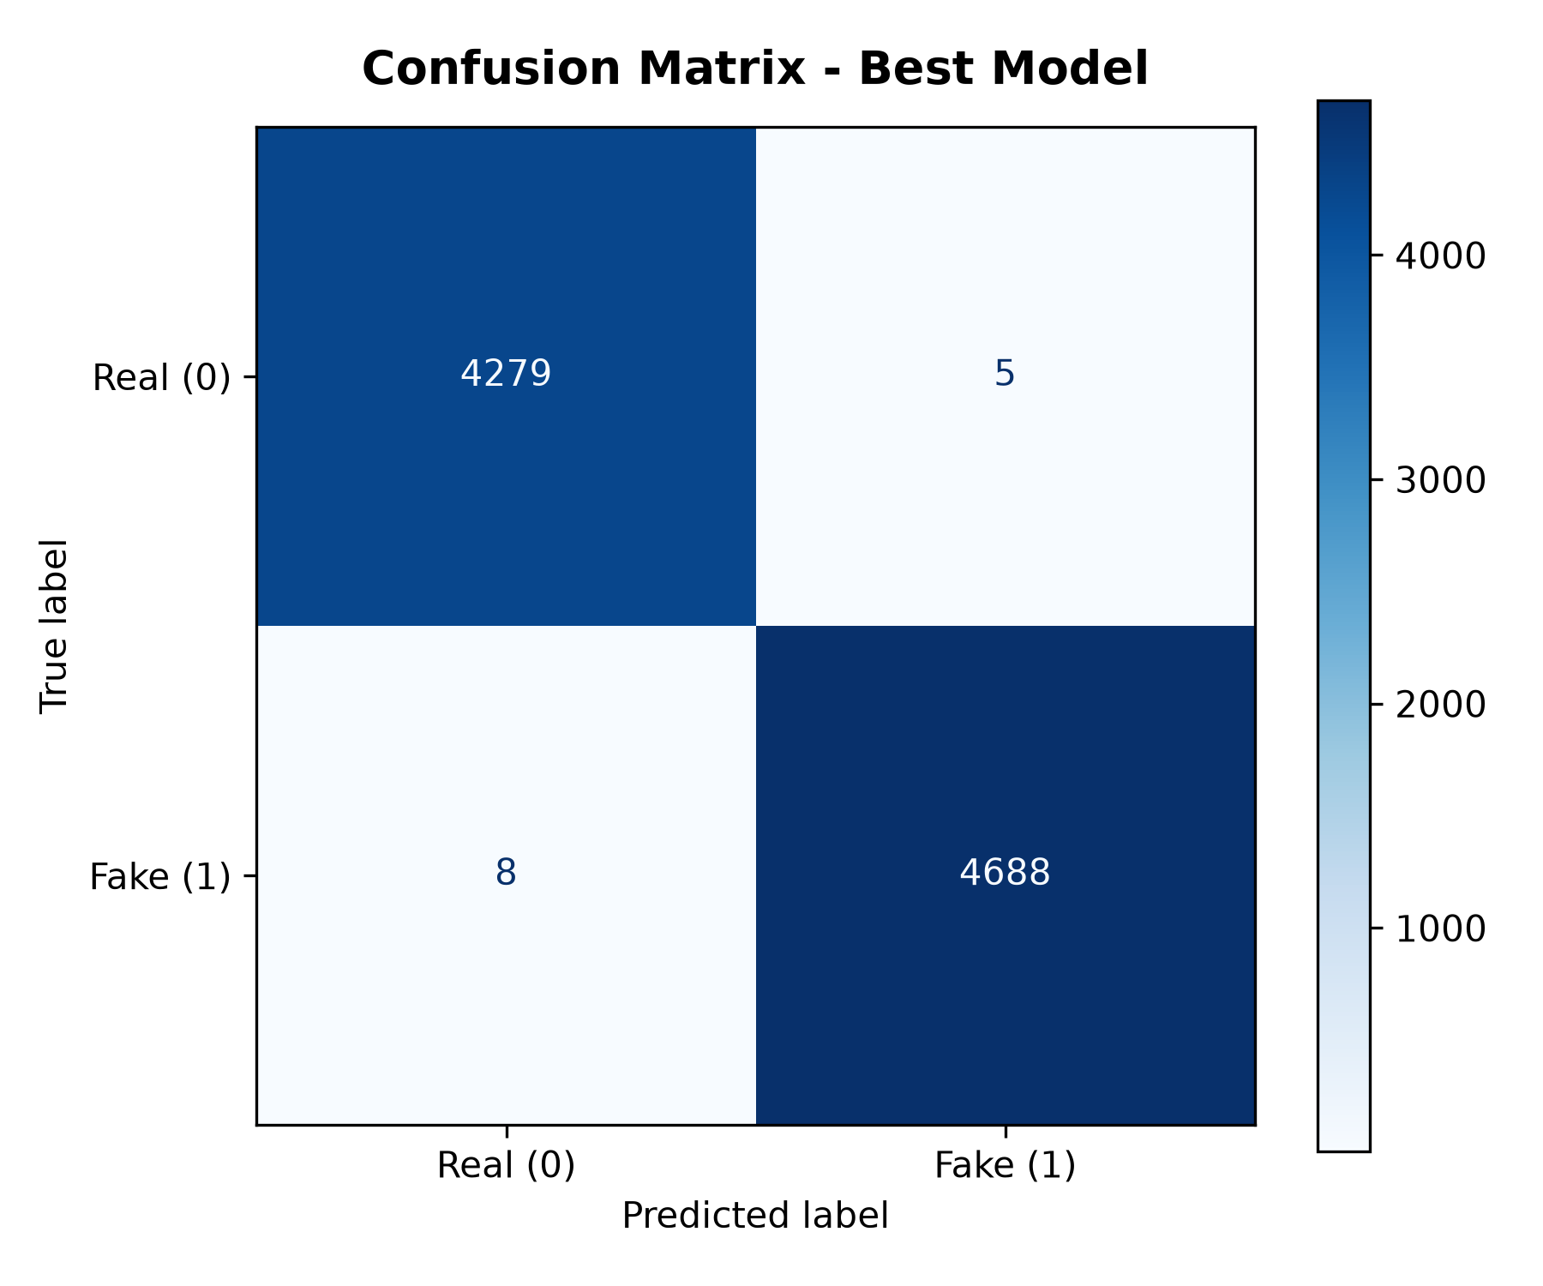
Confusion Matrix
Generated by src/evaluate_models.py
Reading the matrix
• Rows = true class, columns = predicted class
• True Negatives: Real correctly predicted Real
• True Positives: Fake correctly predicted Fake
• Diagonal dominated → almost perfect classification
Key takeaway: only a handful of articles are misclassified out of 8,980 test samples — the model rarely confuses real and fake news.
Confusion matrix of the best model (project-generated image)
AI-Powered Fake News Detection System
18
Notes:
The confusion matrix compares true labels against predicted labels. The diagonal entries hold correct predictions, and off-diagonal entries are errors. In our best model the diagonal completely dominates, confirming that the classifier rarely confuses the two classes. This matrix was generated automatically by evaluate_models.py at 300 dpi.
[VIVA] Q: How do you read a confusion matrix?
A: Rows are the actual class, columns the predicted class. Top-left is true negative (Real), bottom-right true positive (Fake); off-diagonals are misclassifications.
[VIVA] Q: Which type of error matters more here?
A: Failing to catch fake news (false negative) arguably matters more because fake content keeps spreading; our recall of 99.83% keeps this error extremely low.

Slide 19
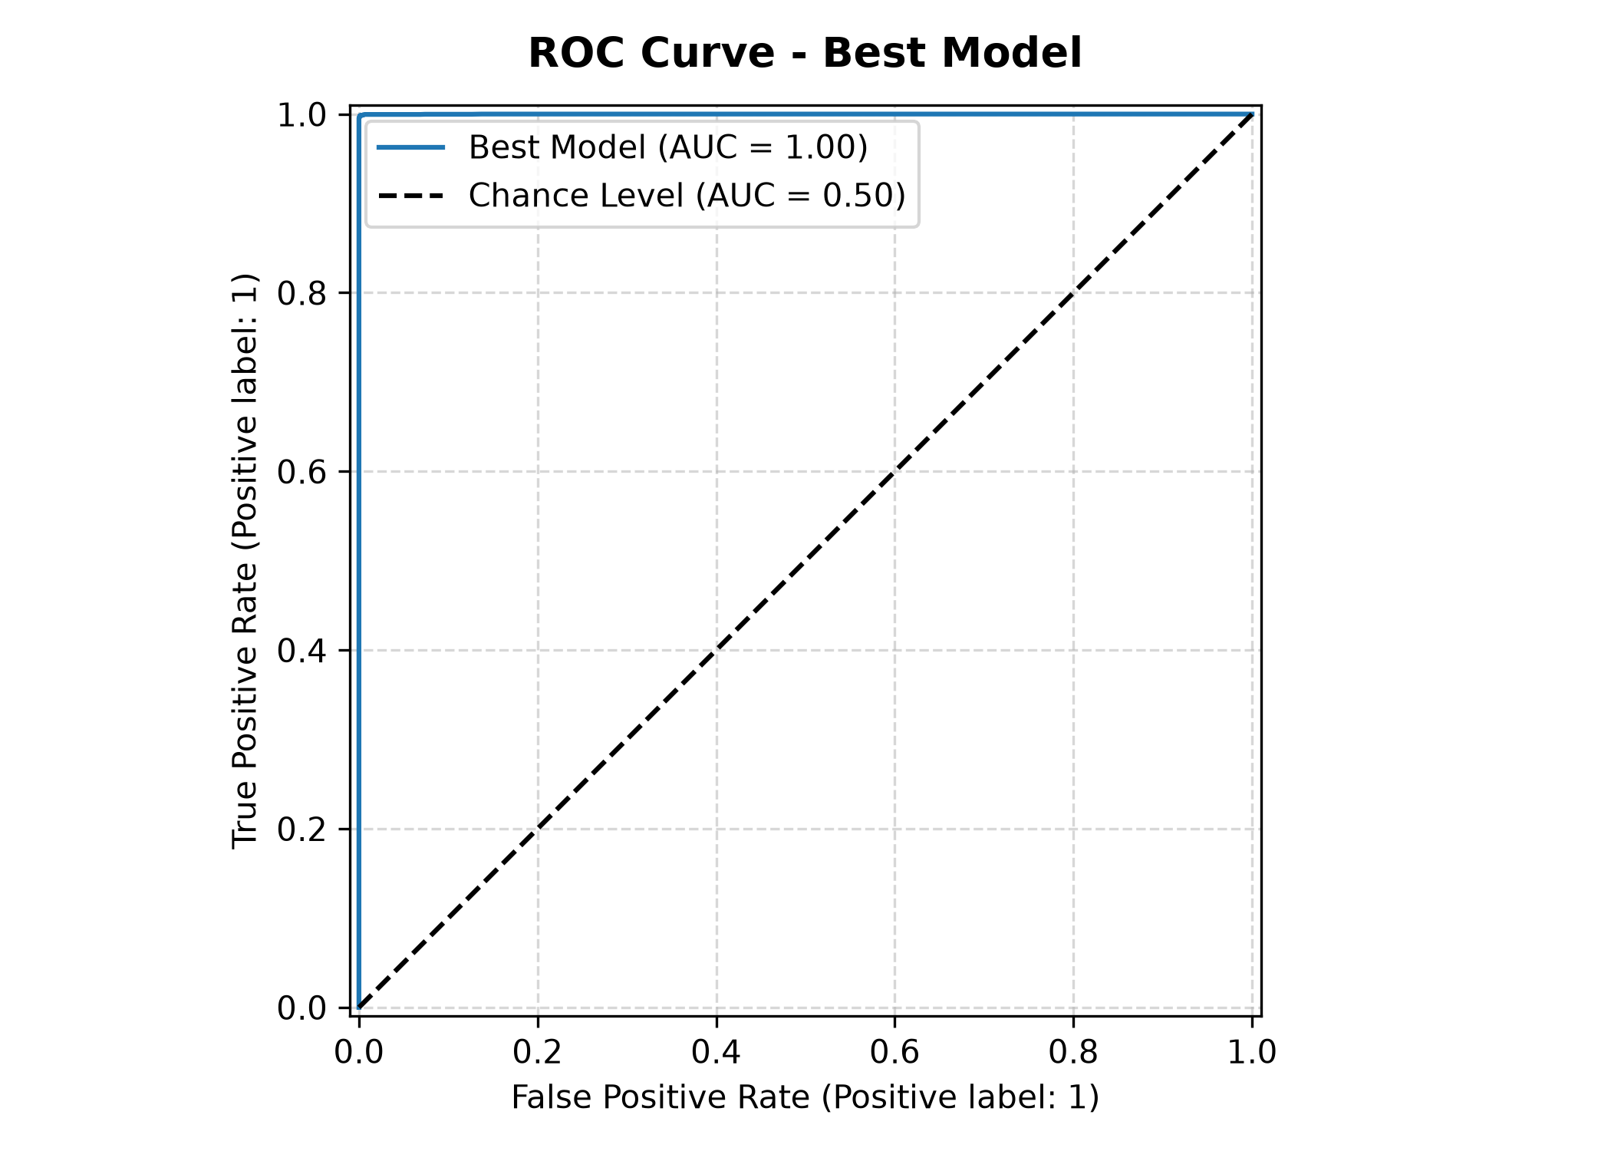
ROC Curve
Generated by src/evaluate_models.py
What it shows
• True Positive Rate vs False Positive Rate at all thresholds
• Curve hugs the top-left corner → strong separation
• Random classifier would follow the diagonal (AUC = 0.50)
• Area under curve measures ranking quality, threshold-free
ROC-AUC = 0.9999Near-perfect ranking of fake articles above real ones
ROC curve of the best model (project-generated image)
AI-Powered Fake News Detection System
19
Notes:
The ROC curve plots the true positive rate against the false positive rate at every possible decision threshold. The best model's curve rises steeply to the top-left corner, meaning it can achieve very high recall with almost no false positives. The area under the curve, 0.9999, is a threshold-free measure of how well the model separates fake from real articles.
[VIVA] Q: What does AUC = 0.9999 mean?
A: It means that for a randomly chosen fake article and a randomly chosen real article, the model ranks the fake one higher 99.99% of the time.
[VIVA] Q: Why show ROC-AUC and not just accuracy?
A: AUC summarises performance across all thresholds and is robust to class imbalance, unlike a single accuracy point.

Slide 20
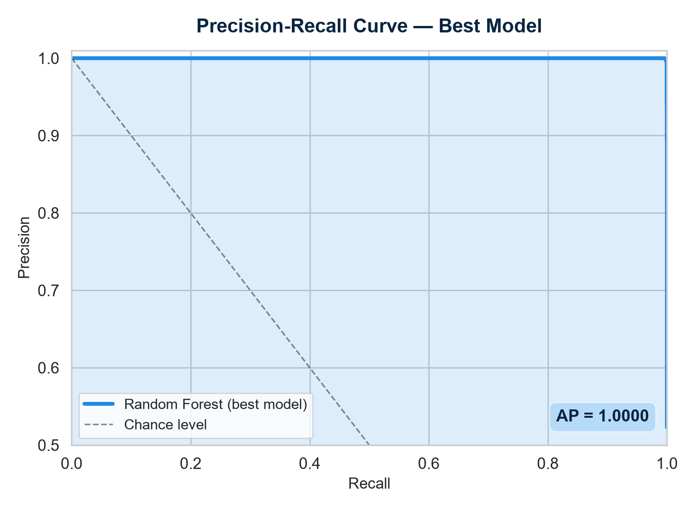
Precision-Recall Curve
Computed from the deployed model's test predictions
What it shows
• Precision vs recall trade-off as the threshold changes
• Precision stays near 1.0 even at very high recall
• Focuses on the positive (Fake) class — key for detection
• Average Precision (AP) summarizes the whole curve
Average Precision = 1.0000Precision ≈ 100% at every recall level on this corpus
Precision-Recall curve of the Random Forest model
AI-Powered Fake News Detection System
20
Notes:
Because detecting fake news is fundamentally a positive-class problem, the precision-recall curve is very informative. It shows that even when we demand very high recall — catching almost every fake article — precision remains at practically 100%. The average precision score of 1.0000 confirms the model's reliability. This curve was computed directly from the deployed model's predictions on the 8,980 test samples.
[VIVA] Q: Why analyse precision-recall in addition to ROC?
A: With near-balanced classes both are valid, but precision-recall emphasizes the positive (fake) class and exposes behaviour that ROC can obscure.
[VIVA] Q: What is Average Precision?
A: It is the area under the precision-recall curve, a single summary number between 0 and 1.

Slide 21
System Architecture
Layered design of the complete application
PRESENTATION LAYER
Streamlit Web App • 5 tabs: Detector | Batch | Models | Dataset | History
APPLICATION LAYER
Prediction Engine: clean_text() → vectorizer.transform() → model.predict() → verdict + confidence
MODEL LAYER
Random Forest classifier (best_model.pkl) • TF-IDF vectorizer (vectorizer.pkl) • feature names
DATA LAYER
GlobalFakeNews_Research2026_v1.csv • cleaned_news.csv • model_metrics.json • prediction_history.csv
Flows: presentation → application → model → data. Each layer is a separate module for maintainability.
AI-Powered Fake News Detection System
21
Notes:
The architecture is organised in four layers. At the top, the Streamlit presentation layer exposes five tabs to the user. The application layer is the prediction engine: it cleans the input text, transforms it with the fitted vectorizer and runs the model to produce a verdict and confidence. The model layer holds the serialized Random Forest, TF-IDF vectorizer and feature names. The data layer stores the raw and cleaned datasets, the metrics JSON and the prediction history log. Every layer maps directly to files in the project, which keeps the design clean and testable.
[VIVA] Q: What are the four layers?
A: Presentation (Streamlit UI), Application (prediction engine), Model (serialized artifacts) and Data (datasets, metrics, history).
[VIVA] Q: How does the UI communicate with the model?
A: The app imports clean_text from src/utils.py, loads best_model.pkl and vectorizer.pkl with caching, and transforms text through the vectorizer before predicting.

Slide 22
Workflow Diagram
End-to-end flow from article to verdict
Article Input
paste text
or upload CSV
Text Cleaning
lowercase,
strip noise
Tokenize
split into
tokens
Stopword Removal
remove
NLTK list
Lemmatization
WordNet
base forms
TF-IDF
5,000-dim
features
Classifier
Random
Forest
Verdict
REAL / FAKE
+ confidence
Offline (training)Same cleaning + TF-IDF steps build the training matrix; the fitted vectorizer and best model are serialized and reused at inference time.
Online (inference)For one article the same steps run in real time, then the verdict, confidence and charts are shown and the record is appended to the history CSV.
Consistency is the point: training and serving share the identical preprocessing and vectorization, so the deployed model behaves exactly as evaluated.
AI-Powered Fake News Detection System
22
Notes:
This is the complete workflow. On the left, an article enters the pipeline: cleaning, tokenization, stopword removal, lemmatization, then TF-IDF vectorization, then the Random Forest classifier, and finally a verdict with confidence. The same chain is used offline for training and online for inference, which guarantees that what we evaluate is exactly what we deploy. The trained vectorizer is saved and reused so new articles are transformed identically.
[VIVA] Q: Why reuse the same fitted vectorizer?
A: The vectorizer's vocabulary and IDF weights were learned during training; reusing it keeps new inputs in the same feature space.
[VIVA] Q: Where is the verdict generated?
A: In app/app.py: prediction from best_model.predict() and confidence from predict_proba(), the max probability of the two classes.

Slide 23
Prediction Pipeline
How the app turns input text into a verdict — app/app.py
Input
title +
article text
Clean
clean_text()
NLTK pipeline
Vectorize
vectorizer.
transform()
Predict
model.predict()
+ predict_proba()
Verdict
REAL/FAKE
+ confidence %
Log
append to
history CSV
Key implementation details
1
Model loading — Loaded once via @st.cache_resource — model, vectorizer and metrics stay in memory across interactions.
Sample loader — Built-in REAL_NEWS and FAKE_NEWS samples in app/sample_news.py let you demo instantly.
4
2
Confidence — confidence = max(predict_proba) × 100. Borderline cases are easy to spot.
Text statistics — Shows word count, character count and cleaned-token count after preprocessing.
5
3
Feedback loop — Every prediction is appended to results/prediction_history.csv with timestamp, title, verdict and confidence.
Visual analytics — Probability bar chart (Plotly) splits REAL vs FAKE probability side by side.
6
AI-Powered Fake News Detection System
23
Notes:
The prediction pipeline is implemented in app/app.py. When the user clicks Predict, the text is cleaned with clean_text(), transformed with the fitted vectorizer, and classified. predict() gives the verdict and predict_proba() gives the class probabilities; confidence is the maximum probability multiplied by 100. The result is rendered with badges, a probability bar chart and text statistics, and the record is appended to the history CSV. The model is loaded once through Streamlit's caching to keep predictions fast.
[VIVA] Q: Why the @st.cache_resource decorator?
A: It loads the 47 MB model and vectorizer into memory only once, so every interaction reuses them instead of reloading from disk.
[VIVA] Q: How is confidence calculated?
A: confidence = max(predict_proba(x)) × 100, i.e. the probability of the predicted class.
[VIVA] Q: What gets stored in history?
A: Timestamp, article title, verdict (REAL/FAKE) and confidence percentage — with CSV export and clear options in the History tab.

Slide 24
Streamlit Dashboard
Five functional tabs built with Streamlit + Plotly
Real-time detection with title + article text input, sample loader, confidence metric, probability chart and cleaned-text view
Detector
Upload a CSV, map the text column, run bulk classification with a progress bar, get summary cards, pie chart and downloadable results
Batch
Live performance table, editable bar charts (accuracy, precision, recall, F1, ROC-AUC), confusion matrix, ROC curve and top features
Models
Explorer with class distribution, article-length histograms and per-class average length computed from the raw CSV
Dataset
Audit log of every prediction with search, verdict filter, pie summary, CSV export and clear-history action
History
Styled with custom glassmorphism CSS (app/style.css) and a dark-blue radial-gradient theme.
AI-Powered Fake News Detection System
24
Notes:
The dashboard is organised into five tabs. The Detector handles single-article prediction with a confidence gauge and probability chart. Batch handles CSV uploads for bulk classification, with a progress bar, summary metrics and downloadable results. Models displays live benchmark tables and charts built directly from model_metrics.json. Dataset lets you explore class and length distributions. History maintains an audit trail with search, export and clear actions. The whole UI uses a custom glassmorphism CSS theme.
[VIVA] Q: Which library powers the charts?
A: Plotly Express and Plotly Graph Objects — the charts are interactive and rendered inside Streamlit.
[VIVA] Q: How does the Models tab get its data?
A: It reads results/model_metrics.json and renders tables and charts programmatically, so the dashboard always reflects the latest training run.

Slide 25

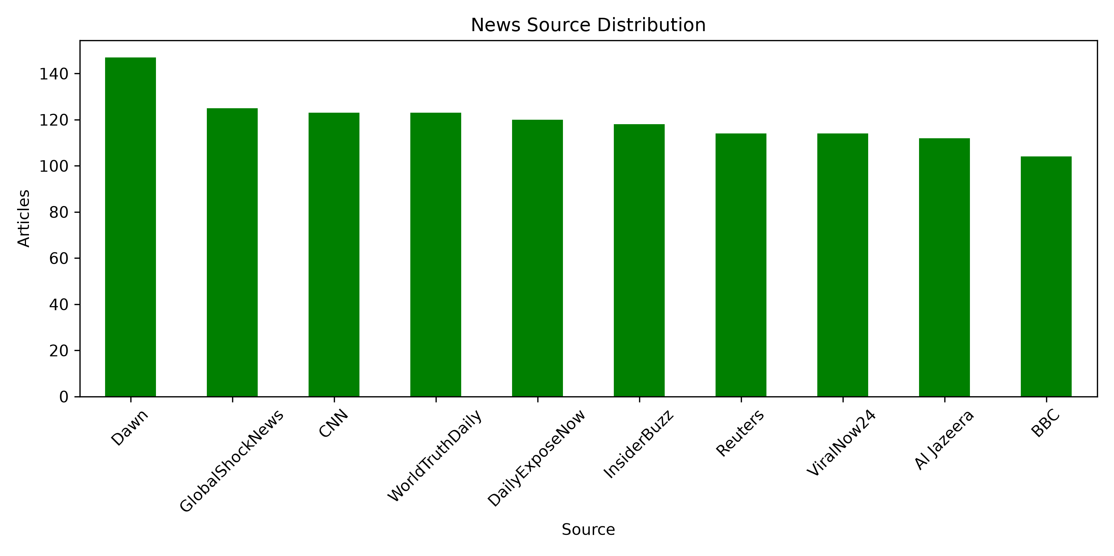
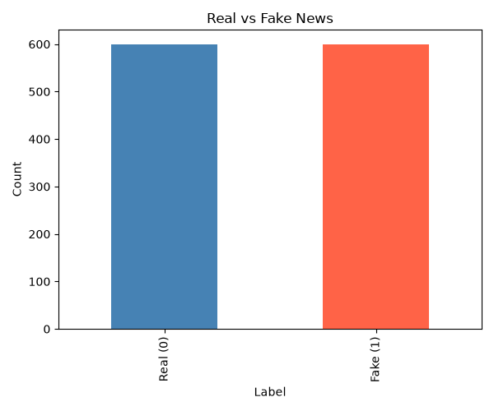
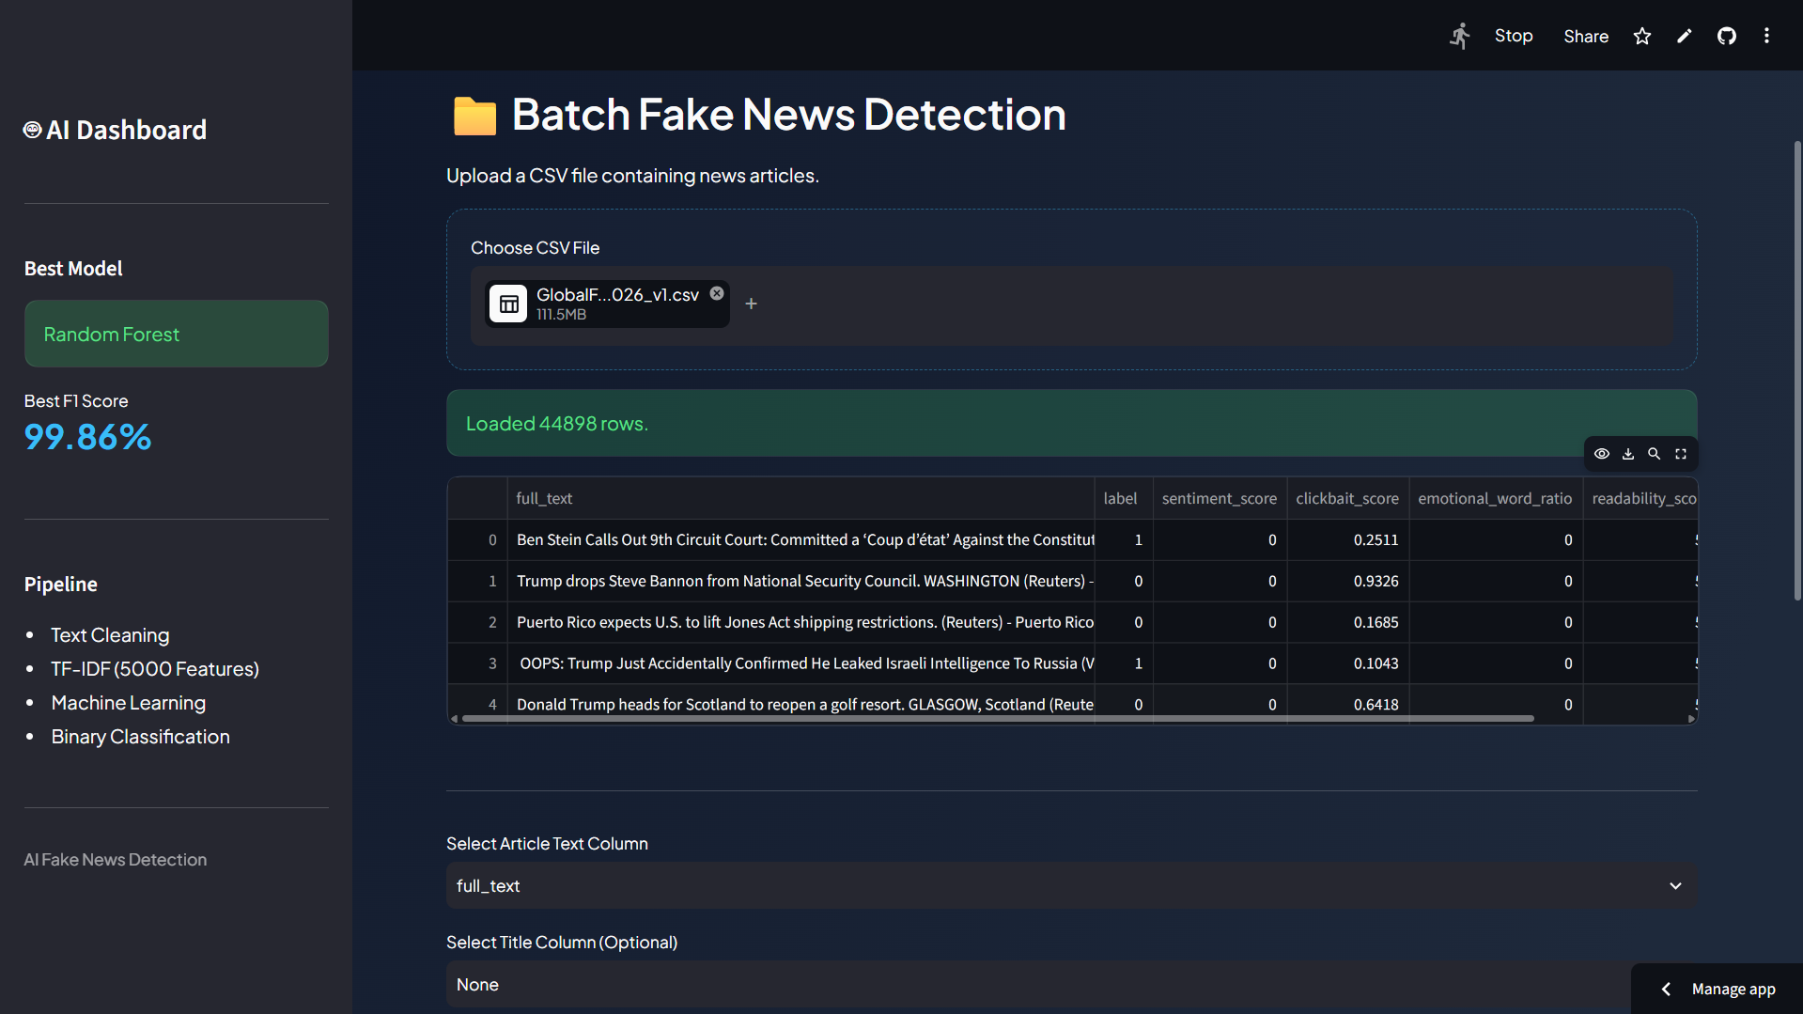

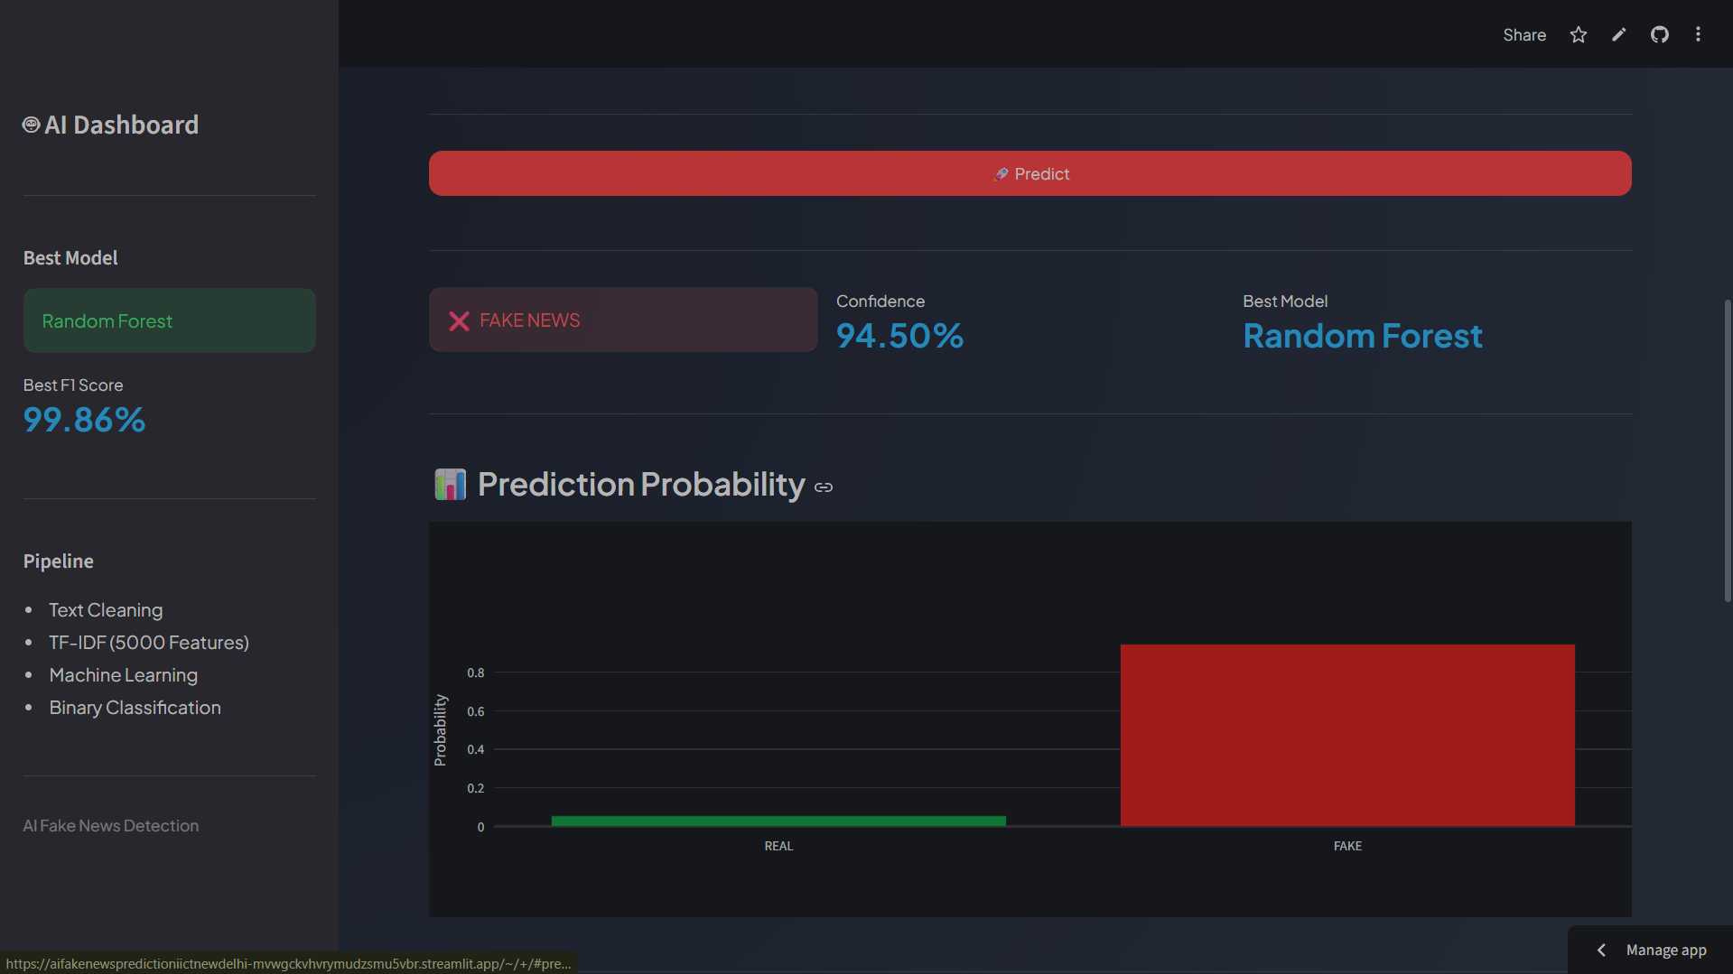
Live Prediction Demo
Screenshots captured from the running application
Home page — hero + detector tab
Prediction result with confidence
Batch CSV prediction summary
Dataset explorer — class distribution
Prediction history audit log
Probability split chart
AI-Powered Fake News Detection System
25
Notes:
These are real screenshots captured from the running Streamlit application. The home page greets the user with the detector. A sample article produces a verdict with a confidence percentage and a probability chart. The batch tab classifies a whole CSV at once, the dataset tab visualizes the corpus, and the history tab keeps an audit log. Whenever possible, demo the app live: press 'Load Fake Sample', click Predict, and show the 100% FAKE verdict and confidence gauge. Then switch to the batch tab and upload a CSV.
[VIVA] Q: How do you demo the app quickly?
A: Use the built-in sample loader: 'Load Real Sample' and 'Load Fake Sample' buttons populate the inputs, so a demo takes two clicks.
[VIVA] Q: What should the audience look at first?
A: The verdict badge, the confidence percentage and the probability bar — those are the core outputs of the system.

Slide 26
Advantages
Strengths of the implemented system
✔ High Accuracy
✔ Fast Real-Time Detection
99.86% accuracy and 0.9999 ROC-AUC on the benchmark test set
Single-article prediction completes instantly via cached model
✔ Batch Support
✔ Explainable Confidence
Bulk classification of entire CSV files with summary analytics
Probability + confidence shown for every verdict
✔ Modular Codebase
✔ Complete Audit Trail
Clean separation of preprocessing, features, training, evaluation and UI
Prediction history with search, export and clear actions
✔ Reproducible Training
✔ Accessible UI
Fixed random_state, stratified split and saved artifacts
Streamlit dashboard usable without any programming knowledge
AI-Powered Fake News Detection System
26
Notes:
The system's main strengths: very high accuracy on the benchmark, instant real-time prediction thanks to caching, bulk CSV support, and a transparent confidence score for every verdict. The codebase is modular, the training is reproducible with a fixed random state and stratified split, and the interface is accessible to non-technical users while still offering a full audit trail of predictions.
[VIVA] Q: What makes predictions fast?
A: The model and vectorizer are loaded once with Streamlit's cache_resource and reused across all interactions.
[VIVA] Q: How is the system user-friendly?
A: No-code UI, sample articles, batch upload, clear verdict badges and downloadable reports.

Slide 27
Limitations
Honest assessment of current constraints
Benchmark-Specific Results
Static, Offline Dataset
99.86% accuracy is measured on this corpus; performance on unseen, real-world news may vary with content diversity and quality (as noted in the project README).
The model is trained on a fixed dataset; there is no live news feed or automatic retraining yet.
No Deep Semantics
English-Only
TF-IDF captures surface word statistics, not meaning — synonyms, sarcasm or heavily manipulated text can evade it.
Preprocessing and models target English news; other languages are unsupported.
Heuristic Metadata
Class Near-Balance Dependency
Auxiliary scores like source_trust_score are default heuristics, not learned ground truth.
Deployed metrics assume roughly balanced classes; heavily skewed real-world streams would need threshold tuning.
AI-Powered Fake News Detection System
27
Notes:
It is important to present limitations honestly. The near-perfect scores are specific to this benchmark dataset and may not generalize to entirely new articles. The model is trained offline on a fixed corpus — there is no live retraining. TF-IDF has no semantic understanding, so cleverly rewritten misinformation can slip through. The system works for English only, and some metadata scores are simple heuristics. Acknowledging these makes the project more credible in a viva.
[VIVA] Q: Does the model work on any news text?
A: It was trained on this corpus; on different distributions accuracy may drop, which the README explicitly warns about.
[VIVA] Q: Why is TF-IDF semantically limited?
A: It treats words as independent weighted tokens and ignores word order beyond bigrams, context and meaning.

Slide 28
Future Scope
Planned enhancements beyond the current version
BERT & Deep Learning
Live News API Integration
Fine-tune transformer models (BERT) for contextual, semantically-aware detection
Connect real-time news feeds for continuous monitoring and automatic classification
Multilingual Detection
Explainable AI (XAI)
Extend preprocessing and training to non-English article datasets
LIME / SHAP explanations so every verdict is interpretable by end users
User Authentication
Cloud Deployment
Accounts, roles and personalized prediction histories
Deploy the Streamlit app to a cloud platform for public accessibility
Mobile Application
Synthetic Metadata Learning
Wrap the model in a mobile-friendly interface
Replace heuristic metadata scores with learned feature representations
AI-Powered Fake News Detection System
28
Notes:
The future roadmap comes straight from the README and the technical report. The most exciting direction is transformer-based models such as BERT, which understand context rather than just word frequencies. Other directions include live news API integration, multilingual support, explainable AI for transparency, user authentication, cloud deployment and a mobile app.
[VIVA] Q: What is the single most impactful future upgrade?
A: Fine-tuning a BERT-style transformer, since it captures context and meaning instead of surface term statistics.
[VIVA] Q: Why add explainability?
A: Users trust the system more when they can see why an article was flagged, which also helps auditors verify fairness.

Slide 29
Conclusion
Summary of the completed work
An end-to-end AI-powered fake news detection system was designed, trained and deployed — from raw news text to an interactive web dashboard.
1
Pipeline — NLP cleaning → TF-IDF (5,000 features) → supervised classification
2
Benchmark — 4 models compared; Random Forest selected by F1 score
3
Performance — 99.86% accuracy, 99.86% F1, 0.9999 ROC-AUC on 8,980 test articles
4
Deployment — Streamlit dashboard: real-time detector, batch, models, dataset, history
5
Deliverables — Best model + vectorizer artifacts, metrics JSON, report, notebook and this deck
Demonstrates practical skills in NLP, feature engineering, model evaluation and full-stack ML deployment.
AI-Powered Fake News Detection System
29
Notes:
To conclude: the project delivers a complete pipeline — text preprocessing, TF-IDF feature extraction, benchmarked machine learning models and a deployed Streamlit dashboard. Random Forest was selected as the best model, achieving 99.86% accuracy and an F1 of 99.86% on the held-out test set. The work demonstrates end-to-end skills in NLP, feature engineering, model evaluation and full-stack ML deployment, all organized as a clean, modular codebase.
[VIVA] Q: What is your biggest learning?
A: Building a real ML product requires careful data cleaning, consistent training/serving pipelines, rigorous evaluation and a usable interface — not just fitting a model.
[VIVA] Q: What would you improve first?
A: Move to transformer-based embeddings and retrain on a larger, multilingual, live-updated dataset.

Slide 30
References
Key sources and documentation used
1
Scikit-Learn — Machine Learning library documentation — scikit-learn.org
2
ISOT Fake News Dataset — Ahmed, H., Traore, I., Saad, S. (2017). Detection of Online Fake News using N-Gram Analysis and Machine Learning Techniques — fake & true news corpora used in this project.
3
NLTK — Natural Language Toolkit — stopwords and WordNet lemmatizer corpora (nltk.org)
4
Streamlit — Web application framework documentation — docs.streamlit.io
5
TF-IDF — Salton, G. & Buckley, C. (1988). Term-weighting approaches in automatic text retrieval.
6
Plotly — Interactive graphing library documentation — plotly.com/python
7
Project Report — Technical report & IEEE-style write-up included in the repository (report/project_report.md)
AI-Powered Fake News Detection System
30
Notes:
The references are the tools and datasets actually used in this project: Scikit-Learn for the classifiers and metrics, the ISOT fake news corpora that form our dataset, NLTK for text preprocessing, Streamlit for the interface, the classic Salton & Buckley paper on TF-IDF weighting, and Plotly for the charts. The detailed technical report is included in the repository.
[VIVA] Q: Which dataset paper supports your data?
A: Ahmed et al. (2017), 'Detection of Online Fake News using N-Gram Analysis and Machine Learning Techniques', which introduced the ISOT fake news dataset.
[VIVA] Q: Where is the full documentation?
A: In the repository: README.md, report/project_report.md and the Jupyter notebook.

Slide 31
Thank You
Questions & Discussion Welcome
AI-Powered Fake News Detection System • Lahya Sree BollinkalaB.Tech Computer Science & Engineering
Machine Learning
Natural Language Processing
TF-IDF
Streamlit
github.com/lahyasreebollinkala • linkedin.com/in/lahyasreebollinkala
Notes:
Thank you for your attention. I'm happy to take questions on any part of the project — the dataset, the preprocessing pipeline, the TF-IDF feature engineering, the model benchmark or the web application. My contact details are on the screen. Thank you.
[VIVA] Q: Be ready for the classic wrap-up:
A: Summarize in one sentence: 'An NLP + TF-IDF + Random Forest pipeline, deployed as a Streamlit dashboard, classifies news as real or fake with 99.86% accuracy.'
[VIVA] Q: Likely closing question:
A: What was the hardest part? — Making training and inference share exactly the same preprocessing/vectorization, and honestly reporting benchmark-limited results.

